Slide 1
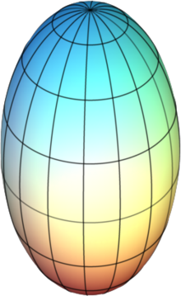
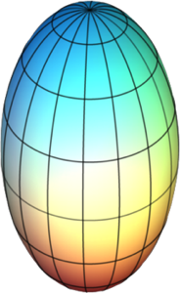
U+U Collisions
Au+Au Collisions
+
+
+

